Slide 1
Pathogenic bacteria.
Dr.Munira Ch. Ismail Lec.7

Slide 2
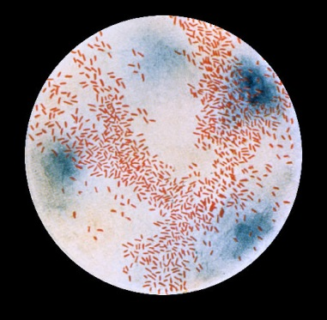
Characteristics:
• This is a group of small gram-negative, non-spore forming,non-motile, pleomorphic bacteria that require enriched.
media for growth.
• Growth is enhanced in CO2 enriched atmosphere.
• Present in upper respiratory tract as a normal microbial flora
in healthy people.
• The group is fastidious requiring growth factors for isolation.
• The growth factors are X-factor(Hematin) andfactor(Diphosphopyridine nucleotide).
. Requirement for growth factor helps for differentiation of species

Slide 3
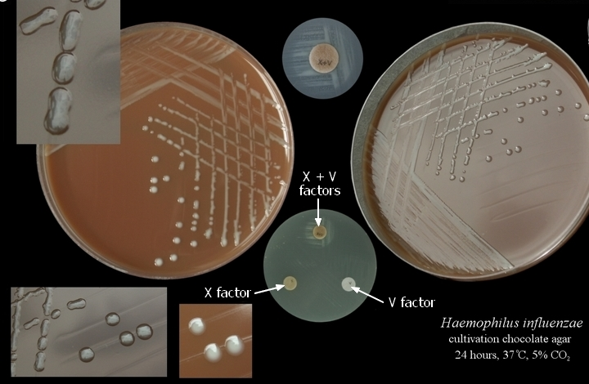
Growth factor required Haemophilus species.
X and V factor H. influenzae, H. aegyptius, H. hemolyticus.
X factor H. ducreyii.
V factor H. parainfluenzae, H. parahemolyticus.

Slide 4
. The main species of medical importance are:
H. influenza.
H. ducreyii.
H. aegyptius.
Haemophilus influenza.
Characteristics:
.Gram-negative cocobacilli.
. Fastidious bacteria requiring growth factors for isolation.
. Found in upper respiratory tract as normal flora in healthy people.
Clinical features: The bacteria causes disease most commonly in young children.
. Acute pyogenic meningitis, Acute epiglottis,Pneumonia,Otitis media,Siusitis, Cellulitis,Acute pyogenic arthritis.

Slide 5
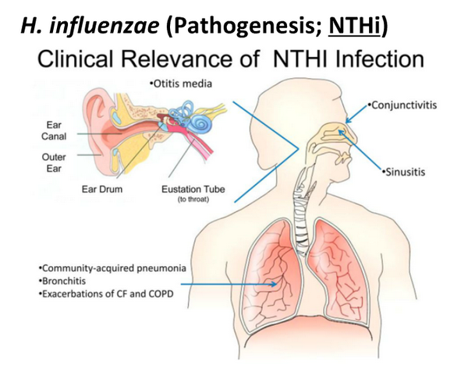

Slide 6
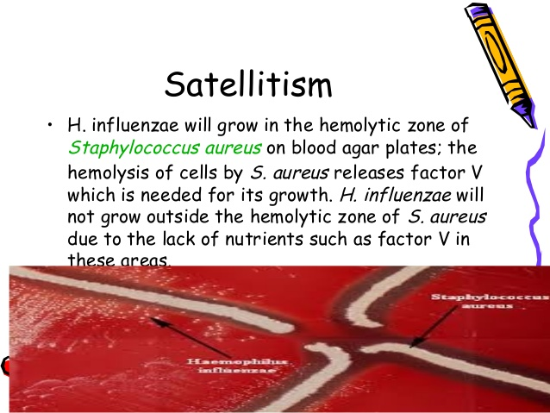
Laboratory diagnosis:
Specimen: Cerebrospinal fluid, sputum, blood, pus.
Smear: Gram-negative short rods.
Culture: Chocolate agar contain both X and V factor; blood agar contain only X factor.
Satellitism test is used to identify H. influenzae in blood agar.
Serology:
Quellung reaction (using specific antisera)Immunofluorescence stain.

Slide 7
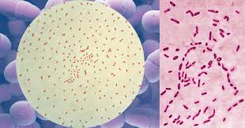
GENUS: BORDETELLA.
Characteristics:
. Minute strictly aerobic non-motile gram-negative rods.
Bordetella species of medical importance:
B. pertussis

Slide 8
Clinical features:
Incubation period: 2 weeks.
Route of transmission is respiratory from early cases and possibly carries.
It has three stages:
1. Catarrhal stage
2. Paroxysmal stage
3. Convalescence stage
During catarrhal stage, the patient is highlyinfectious but not very ill
manifesting with mild coughing and sneezing.
During paroxysmal stage, the patient presents with explosive repetitive cough with characteristic ‘whoop’ upon inhalation leading to exhaustion, vomiting, cyanosis and convulsion.
During convalescence stage, the patient presents with prolonged cough.

Slide 9
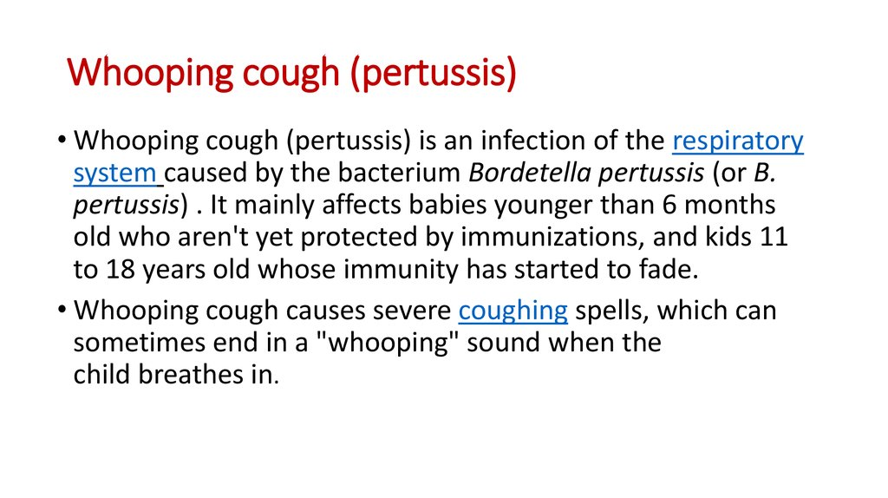

Slide 10
Laboratory diagnosis:
Specimen: Saline nasal wash (Preferred specimen).
Nasopharyngeal swab or cough droplets on cough plate.
Smear: Small, non-motile, capsulated, gram-negative cocobacilli singly or in pair, and may show bipolar staining.
Culture: Inoculate the primary specimen on Bordet-Gengue agar medium and incubate for 2-6 days at 37 oc in a moist aerobic atmosphere which produces small, raised, shiny, mucoid colonies.
Biochemical reaction:
. No growth on blood agar.
. Oxidase positive.
. Most of them are catalase positive.
Serology:
Direct fluorescent antibody test is most helpful, in identifying B. pertussis after culture on solid media.

Slide 11
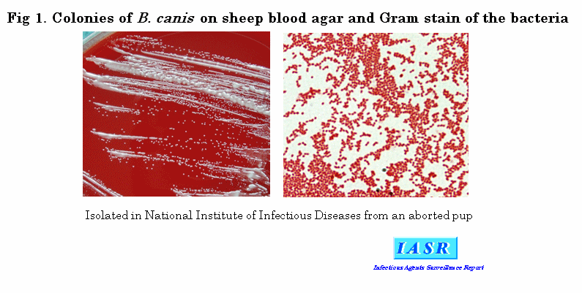
GENUS BRUCELLA.
General characteristics:
• Gram-negative, non-motile, non-sporulating, zoonotic, obligate intracellular aerobic coccobacilli.

Slide 12
• 3 major human pathogenic species.
Species Primary animal host
B.abortus Cattle.
B. melitensis Goat / Sheep.
B. suis Swine.
B.canis Dogs.
Pathogenesis and clinical features:
Brucellosis is a zoonotic disease primarily affecting goat,sheep, cattle, buffalo,pigs and other animals, and transmitted to man by direct contact with infected tissue via skin and mucus membrane , and ingestion of infected milk and milk produts via intestinal tract.
IP=1-6 wks
Brucellosis/ Undulant fever.

Slide 13
2 stages of illness:
Acute stage: Fever, malaise, sweating,hepatosplenomegally, lymphadenopathya ssociated with 80% spontaneous recovery.
2. Chronic stage: Generally associated with hypersensitivity manifestations like fever, chest pain, and arthritis,. High agglutinin titier.
Complication: Brucella spondylitis( Vertebral brucellosis).
Lab. Diagnosis:
Specimen: Blood, Biopsy material (Bone marrow, Lymphnodes).
serum Culture: Grow in blood agar, chocolate agar, or brucella agar
incubated in 10% CO2 at 35-37 0C for 3 wks.
Biochemical reaction:
Non-hemolytic.
Catalase positive.
Oxidase positive.
Urease test positive.
Dye inhibition test positive.
Serology: Agglutination test.
IgG agglutination titer >1:80 indicate active infection

Slide 14
Lab. Diagnosis:
Specimen: Blood, Biopsy material (Bone marrow, Lymphnodes).
serum Culture: Grow in blood agar, chocolate agar, or brucella agar
incubated in 10% CO2 at 35-37 0C for 3 wks.
Biochemical reaction:
Non-hemolytic.
Catalase positive.
Oxidase positive.
Urease test positive.
Dye inhibition test positive.
Serology: Agglutination test.
IgG agglutination titer >1:80 indicate active infection

Slide 15
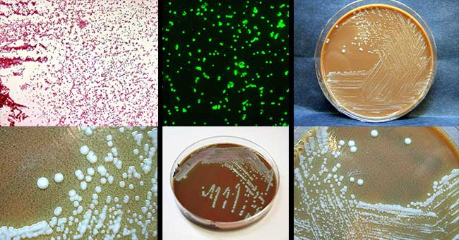
GENUS FRANCISELLA.
Francisella tularensis.
General characteristics:
Small, facutative intracellular, gram negative, nonmotile pleomorphic rods.
Pathogenesis and clinical features:
It is primarily a zoonotic disease and transmitted to human by biting arthropods, direct contact with infected animal tissue, inhalation of aerosols, or ingestion of contaminated food and water.

Slide 16
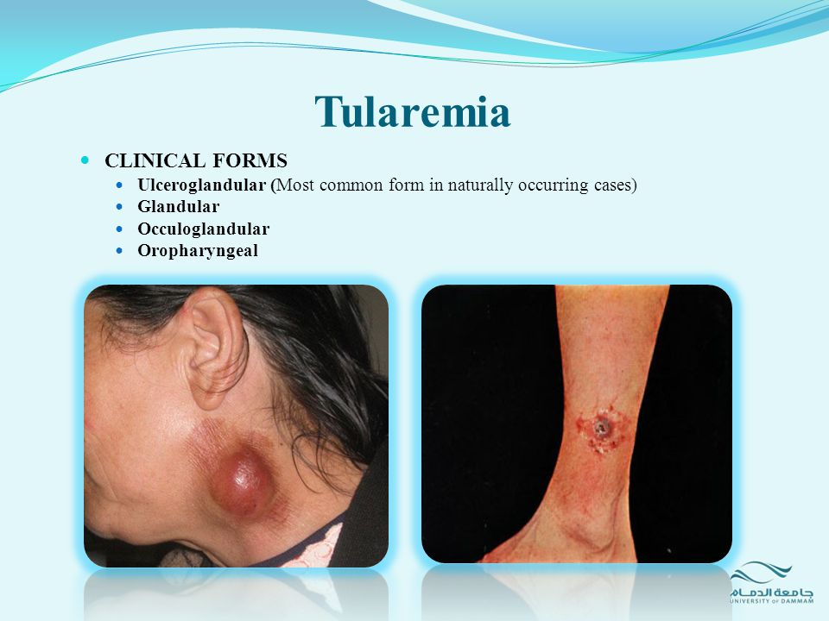
Pathogenesis and clinical features:
It is primarily a zoonotic disease and transmitted to human by biting arthropods, direct contact with infected animal tissue, inhalation of aerosols, or ingestion of contaminated food and water.

Slide 17
Tularemia: 4 types.
1. Ulceroglandular tularemia: Ulceration of arms and hands with lymphadenitis after tick bite or direct contact of broken skin with infected tissue or blood.
2. Oculoglandular tularemia: Accidental contamination of the conjunctiva with infected droplets/aerosols.
3. Pneumonic tularemia: Contracted through contaminated aerosols.
4. Typhoidal tularemia: Following ingestion of inadequately cooked food.
Lab. Dignosis:
Specimen: Skin lesion, lymphnodes, sputum, conjunctival scrapings.
Culture: grow in blood-cysteine-gextrose agar incubated at 37 0c under aerobic condition.
Serology: Agglutination test.
Single titer of ≥ 1:160 is highly suggestive of tularemia,Paired serum samples collected two weeks apart can show a rise in agglutination titer

Slide 18
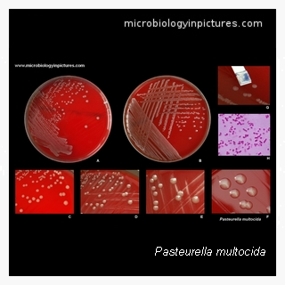
GENUS PASTEURELLA.
General characteristics:
• Gram-negative, non-motile, aerobic or facultative anaerobic coccobacilli with bipolar staining.
• Grow in ordinary media at 37 0c.
• Catalase positive.
• Oxidase positive.

Slide 19
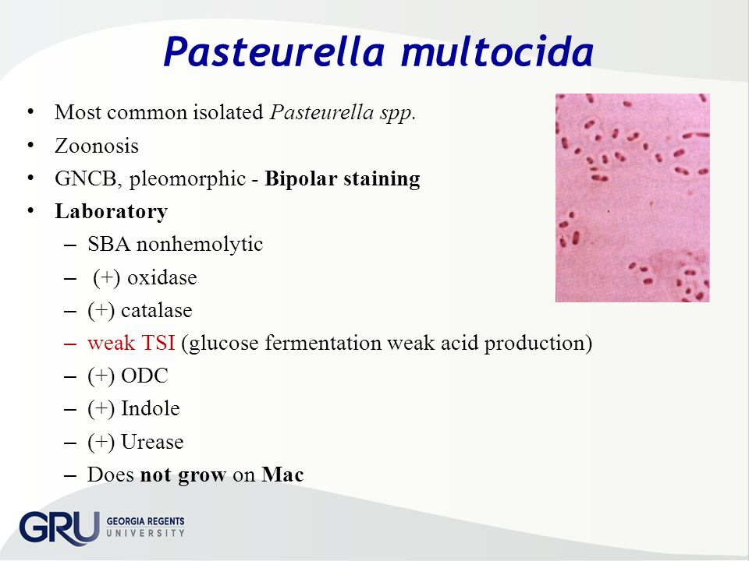
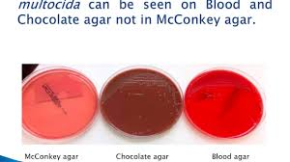

Slide 20
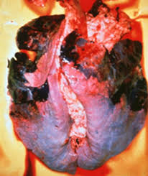
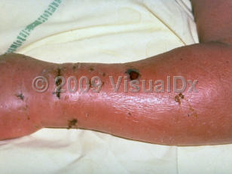
Pasteurella multocida.
• Occur in gasrointestinal and respiratory tract of many domestic and wild animals(fig.1).
• Most common organism in human wounds inflicted by bites from cats and dogs(fig.2).
Fig.1
Fig.2

Slide 21


